Slide 1


Network Adequacy
Data Maintenance Planning
10:00 pm- 11:00 pm Central
July 10, 2025
Regulatory Health Link Division,
Arkansas Insurance Dept., Dept. of Commerce

Slide 2
Agenda
Introductions.
PTNP process delayed.
Customized Justification Template Overview.
Demonstration of the template and validation.
Reporting technical issues.
Visualization into the template data and additional information available.
Q & A

Slide 3
PTNP process delayed
PTNP Round 2 should have been underway by this time of the year starting with provisioning of the Initial template & kick-off meetings at the beginning of every round.
The initial template needs work.
Inclusion of retail pharmacies as a provider type to be monitored.
The General Acute Care Hospital (GACH) list will be taken out of the PTNP data maintenance process and will include CMS-CCIIO’s last published list due August 1, 2025.
Initial seeding issues discovered (Surge in PCPs with specialization etc.

Slide 4
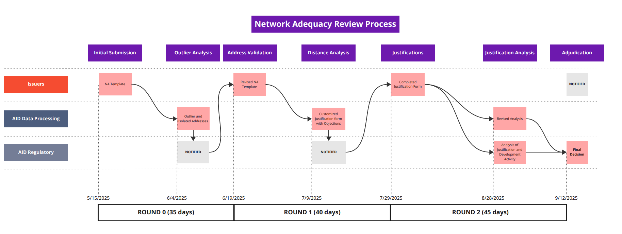
Where are we?
We are here.

Slide 5
Agenda
Introductions.
PTNP process delayed.
Customized Justification Template Overview.
Demonstration of the template and validation.
Reporting technical issues.
Visualization into the template data and additional information available.
Q & A

Slide 6



Round 1: AID’s na Computation
NA Template
(Detailed Data. NPI & Practicing locations)
Current Finalized Provider Type NPI Pool (PTNP)
(Provider classifications vetted by the industry)
Provider locations
Provider classifications
Consumer locations
CCIIO requirements
QHP Sample Population file
(Provided by CCIIO.)
CCIIO NA Drive Distance for each Provider Type & Medicare County type
AID’s Computation of coverage %
Network Shortcomings
AR Justification Template
(Justifications for shortcomings on county level statistics for different provider types)
Customized

Slide 7
Customized Justification Template Overview
More than a justification template, it communicates all network deficiencies.
Department knows when providers are unavailable and such deficiencies are separated out as “Informational” for periodic monitoring – no justifications needed for them.
Objections have been issued when improvement is possible based on the collective data from all issuers. Justifications are needed for all objections
Anyone with a deficiency, categorized as Objections or Informational are required to answer some questions on monitoring and mitigating measures.

Slide 8
Customized Justification Template Overview- contd.
Objectives:
Consolidate all network shortcomings and communications in one document.
Reduce unnecessary back-and-forth communication.
Ensure effective responses with validation.
Action:
Understand details in Overview & User Control tabs *before* starting to work on the template.
Complete and validate. Templates not validated will be considered incomplete.
If NA template needed to be updated submit that as well by the deadline.
Deadline: Submissions by July 29, 2025.

Slide 9
Demonstration of the template & validation.

Slide 10
Reporting technical issues.
If an issuer comes across a bug in the Customized Justification template
Email: RHLD.DataOversight@arkansas.gov
Provide helpful snapshots and the template saved with errors.

Slide 11
Agenda
Introductions.
PTNP process delayed.
Customized Justification Template Overview.
Demonstration of the template and validation.
Reporting technical issues.
Visualization into the template data and additional information available.
Q & A

Slide 12
Visualization into the template data
Published on Tableau Public Server
Network name masked. Issuer identification kept confidential.

Slide 13
Demonstration of the template and validation
PY2026 Objection & Monitoring Information | Tableau Public

Slide 14


Discussions & Questions
Email
RHLD.DataOversight@arkansas.gov

